Slide 1
Defining Business Requirements
4

Slide 2
Contents
Establishing business requirements
Product vision and scope
Scope representation techniques
Context diagram
Ecosystem map
Feature tree
Event list
Impact of business requirements on scope

Slide 3
Business requirements
Business requirements represent the top of the requirements chain.
They define the vision of the solution and the scope of the project that will implement the solution.
The user requirements and functional requirements must align with the context and objectives that the business requirements establish.
Requirements that don’t help the project achieve its business objectives shouldn’t be implemented.
A project without a clearly defined and well-communicated direction invites disaster.
The stakeholders will never agree on the requirements if they lack a common understanding of the project’s business objectives.
Without a common understanding of business objectives up front, project deadlines will likely be missed and budgets will likely be overrun as the team struggles to deliver the right product.

Slide 4
Business requirements
Business requirements refers to a set of information that describes a need that leads to one or more projects to deliver a solution and the desired ultimate business outcomes.
Business opportunities, business objectives, success metrics, and a vision statement make up the business requirements.
Business requirements issues must be resolved before the functional and non-functional requirements can be fully specified.
The business requirements provide a reference for making decisions about proposed requirement changes and enhancements.
Business objectives, vision, and scope highlights can be displayed in every requirements elicitation session so the team can quickly judge whether a proposed requirement is in or out of scope.

Slide 5
Product vision and Project scope
The product vision describes the ultimate product that will achieve the business objectives.
This product could serve as the complete solution for the business requirements or as just a portion of the solution.
The vision describes what the product is about and what it ultimately could become.
The project scope identifies what portion of the ultimate product vision the current project or development iteration will address.
The statement of scope draws the boundary between what’s in and what’s out for this project (or iteration).

Slide 6
Product vision and Project scope
The vision applies to the product as a whole and should change relatively slowly as a product’s strategic positioning or a company’s business objectives evolve over time.
The scope pertains to a specific project or iteration that will implement the next increment of the product’s functionality.
Scope is more dynamic than vision because the stakeholders adjust the contents of each release within its schedule, budget, resource, and quality constraints.

Slide 7
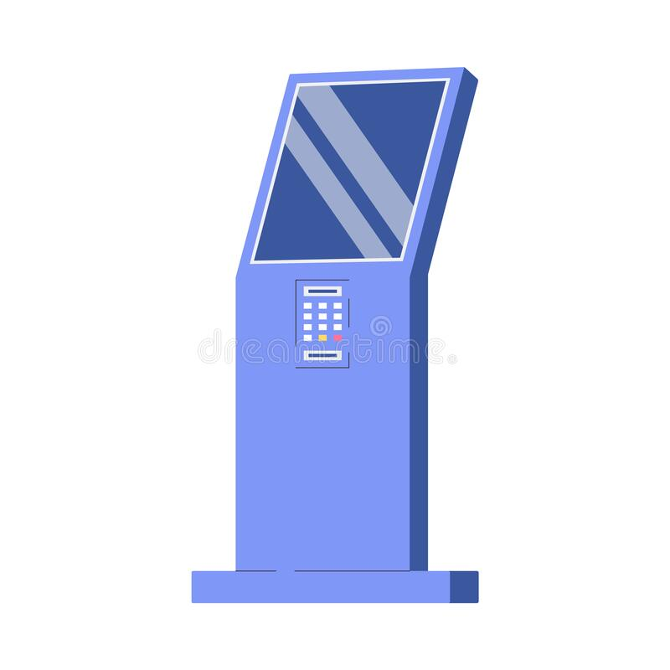
Conflicting business requirements
Business requirements collected from multiple sources might conflict.
Consider a kiosk that will be used by a retail store’s customers.
The interests of three main stakeholders (the kiosk developer, retailer, and customer) may not always match
e.g. the customer wants to spend less time purchasing goods and services, but the retailer would prefer to have customers linger in the store and spend more money.

Slide 8
Conflicting business requirements
The project’s decision makers must resolve the conflicts before the analyst can detail the requirements.
The focus should be on delivering the maximum business value to the primary stakeholders.
The project’s decision makers shouldn’t expect the software team to resolve conflicts among various stakeholders.
A BA can help by surfacing potential areas of conflict and differing assumptions, noting when requested features don’t achieve objectives, and facilitating conflict resolution.
Resolving such issues is often a political and power struggle!

Slide 9
Vision and scope document
The vision and scope document collects the business requirements into a single deliverable that sets the stage for the subsequent development work.
Some organizations create a project charter, a business case document or a market requirements document that serves a similar purpose.
The vision and scope document only defines the scope at a high level; the scope details are represented by each release baseline that the team defines.

Slide 10
Vision and scope document
Business requirements
describe the primary benefits that the new system will provide to its sponsors, buyers, and users
directly influence which user requirements to implement and in what sequence
Scope and limitations
scope describes the concept and range of the proposed solution, what the solution being developed is and what it is not.
limitations itemize certain capabilities that the product will not include that some people might assume will be there.
scope and limitations help to establish realistic stakeholder expectations because customers sometimes request features that are too expensive or that lie outside the intended project scope.
Business context
includes profiles of major stakeholder categories, management’s priorities for the project, and a summary of some factors to consider when planning deployment of the solution.

Slide 11
Vision statement
For scientists who need to request containers of chemicals, the Chemical Tracking System is an information system that will provide a single point of access to the chemical stockroom and to vendors. The system will store the location of every chemical container within the company, the quantity of material remaining in it, and the complete history of each container’s locations and usage. This system will save the company 25 percent on chemical costs in the first year of use by allowing the company to fully exploit chemicals that are already available within the company, dispose of fewer partially used or expired containers, and use a standard chemical purchasing process. Unlike the current manual ordering processes, our product will generate all reports required to comply with federal and state government regulations that require the reporting of chemical usage, storage, and disposal.
A concise vision statement summarizes the long-term purpose and intent of the product.
The following keyword template works well for crafting a product vision statement:
For [target customer]
Who [statement of the need or opportunity]
The [product name]
Is [product category]
That [major capabilities, key benefit, compelling reason to buy or use]
Unlike [primary competitive alternative, current system, current business process]
Our product [statement of primary differentiation and advantages of new product]

Slide 12
A conversation between a business analyst and an executive sponsor to identify business problems and objectives

Slide 13
Business objectives model
From the executive’s responses to the BA’s questions, the BA could construct a business objectives model

Slide 14
Context diagram
The context diagram visually illustrates the boundary and connections between the system you’re developing and everything else
It identifies external entities (terminators) outside the system that interface to it in some way, as well as data, control, and material flows between the terminators and the system.

Slide 15
Ecosystem map
An ecosystem map shows all of the systems related to the system of interest that interact with one another and the nature of those interactions
Shows all the systems that interconnect and that therefore might need to be modified to accommodate your new system
You can identify the affected systems by determining which ones consume data from your system. When you reach the point that your project does not affect any additional data, you’ve identified the scope boundary of systems that participate in the solution

Slide 16
Feature tree
A feature tree is a visual depiction of the product’s features organized in logical groups, hierarchically subdividing each feature into further levels of detail
provides a concise view of all of the features planned for a project, making it an ideal model to show to executives who want a quick glance at the project scope.
can mark up a feature tree diagram to illustrate the feature allocations across releases by using colors or font variations.

Slide 17
Event list
An event list identifies external events that could trigger behavior in the system.
It depicts the scope boundary for the system by naming possible business events triggered by users, time-triggered (temporal) events, signal events received from external components, such as hardware devices.
The event list only names the events
the functional requirements that describe how the system responds to the events would be detailed in the SRS by using event-response tables

Slide 18
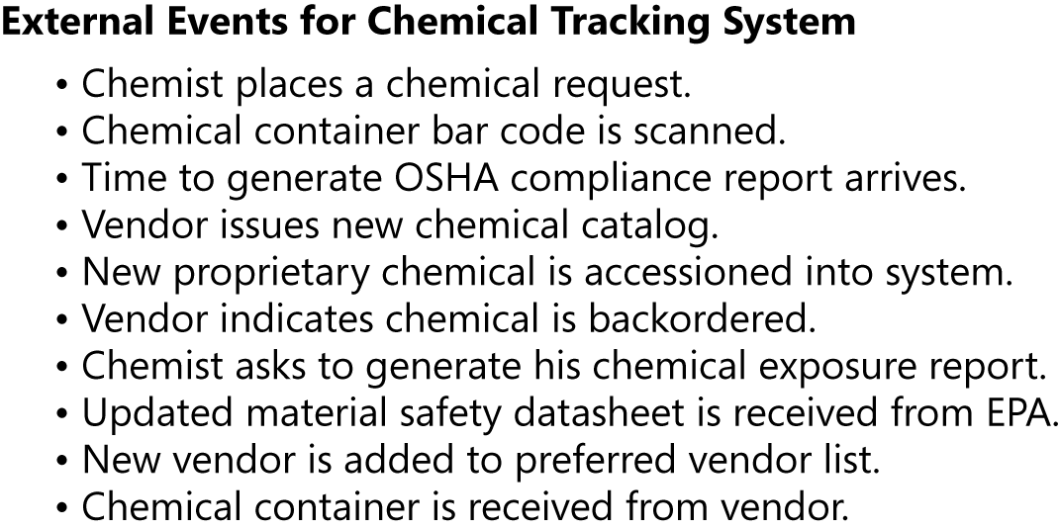
Event list
Partial event list for the Chemical Tracking System:
Notice how the event list complements the context diagram and ecosystem map.
The context diagram and ecosystem map collectively describe the external actors and systems involved, whereas the event list identifies what those actors and systems might do to trigger behavior in the system being specified.

Slide 19

Business objectives and the scope
The business requirements and an understanding of how customers will use the product are valuable when dealing with scope change.
Scope change isn’t a bad thing if it helps you steer the project toward satisfying evolving customer needs.
The information in the vision and scope document lets you assess whether proposed requirements are appropriate for inclusion in the project.
Keep a record of why requirements were rejected
they have a way of reappearing!

Slide 20

Business objectives and the scope
Whenever someone requests a new requirement, the analyst needs to ask, “Is this in scope?” … The responses can be …
The proposed requirement is clearly out of scope.
Perhaps it’s interesting, but it should be addressed in a future release or by another project.
The proposed requirement lies within the defined project scope.
Including new requirements often involves making a decision to defer or cancel other planned requirements, unless you’re willing to extend the project’s duration.
The proposed requirement is out of scope, but it’s such a good idea that the scope should be broadened to accommodate it
Incurs corresponding changes in budget, schedule, and/or staff.
Requires updating the vision and scope document

Slide 21
Summary
Focus on defining clear business requirements for all of your projects.
Otherwise, you are just wandering about aimlessly hoping to accomplish something useful without any way to know if you’re reaching your destination.
Use different artifacts and documents to clarify business requirement and scope
Product vision and scope
Context diagram
Ecosystem map
Feature tree
Event list
Business requirements help you in managing scope and determining when you can stop implementing functionality to declare a project complete

Slide 22
Excercise
A client (played by your teacher) has approached you to develop a software.
Talk to the client and stablish the following:
Vision statement of the product
Business objectives model
Context diagram
Ecosystem map
Event list

